Slide 1
Theory of Formal Languages

Slide 2
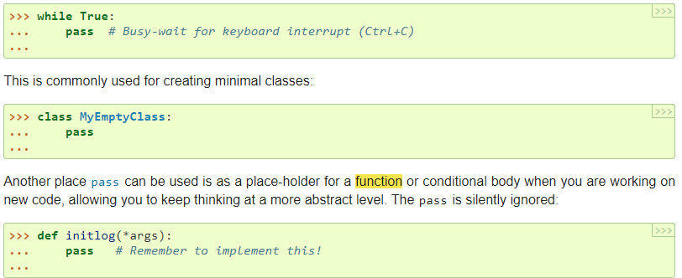
The pass statement does nothing. It can be used when a statement is required syntactically but the program requires no action.
The pass statement is a null operation since nothing happens when it is executed. It is used in the cases where a statement is syntactically needed but we do not want to use any executable statement at its place.
For example, it can be used while overriding a parent class method in the subclass but don't want to give its specific implementation in the subclass.
Pass is also used where the code will be written somewhere but not yet written in the program file.

Slide 3
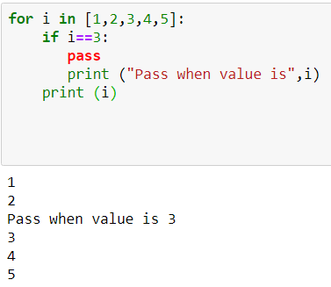
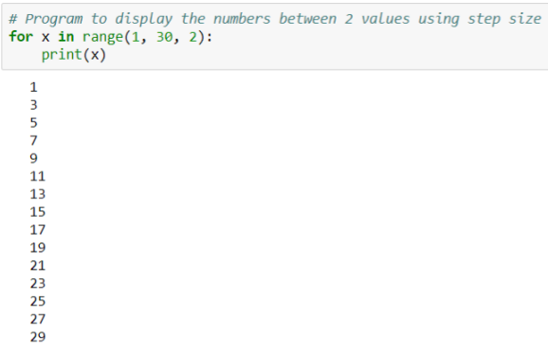
`

Slide 4
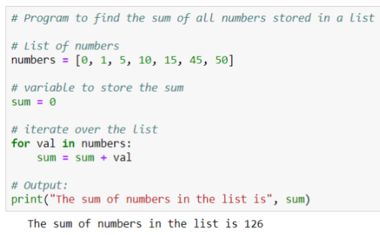

Slide 5
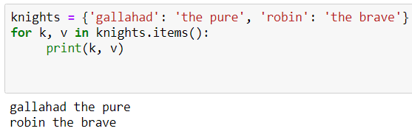
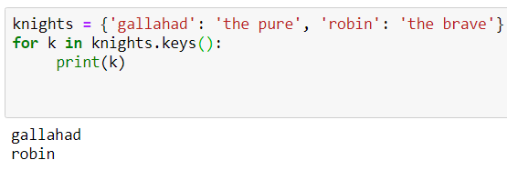
When looping through dictionaries, the key and corresponding value can be retrieved at the same time using the items() method.
Just write knights.values() if you want values of dictionaries

Slide 6
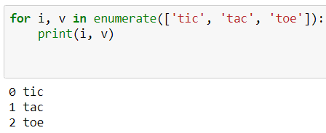
When looping through a sequence, the position index and corresponding value can be retrieved at the same time using the enumerate() function.

Slide 7
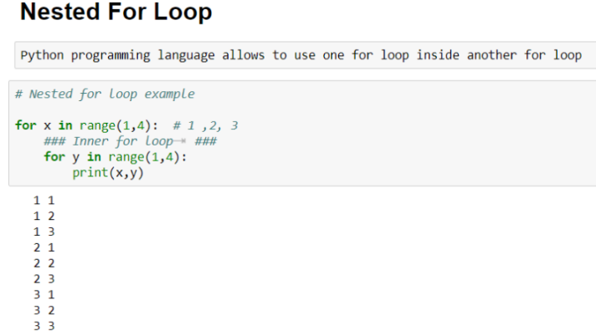
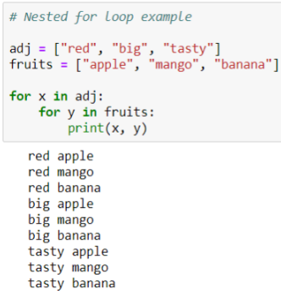

Slide 8
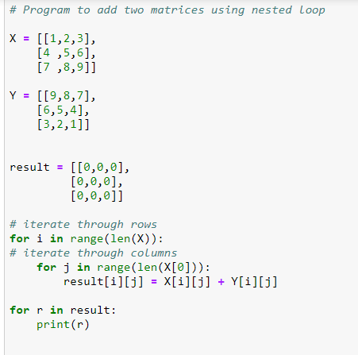
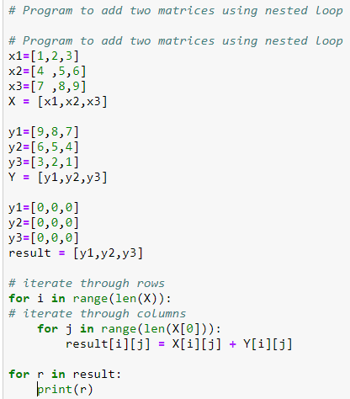

Slide 9
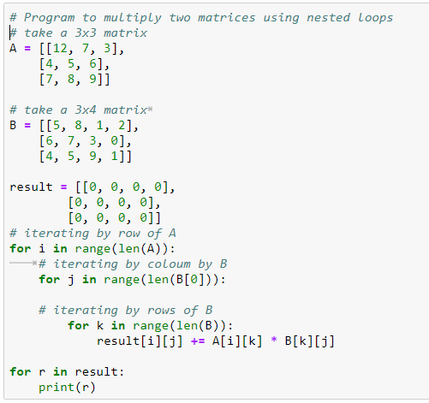

Slide 10
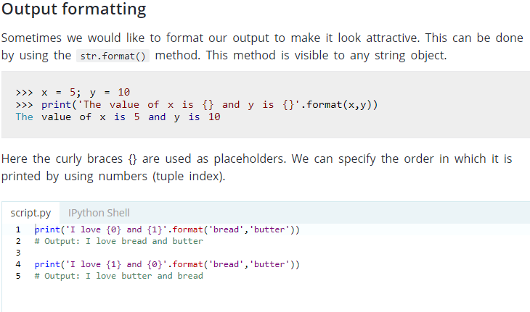

Slide 11
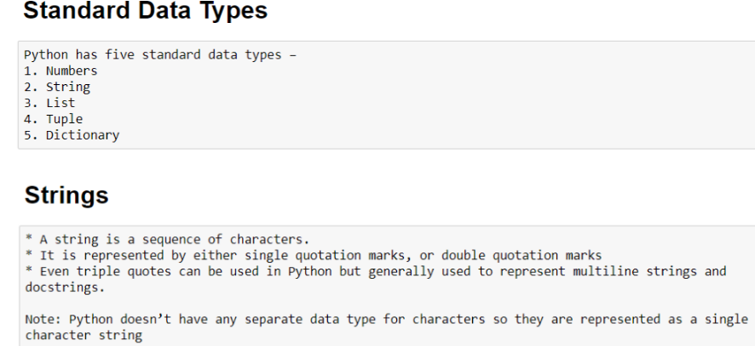

Slide 12
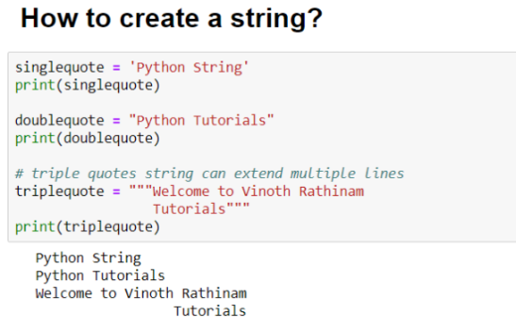

Slide 13
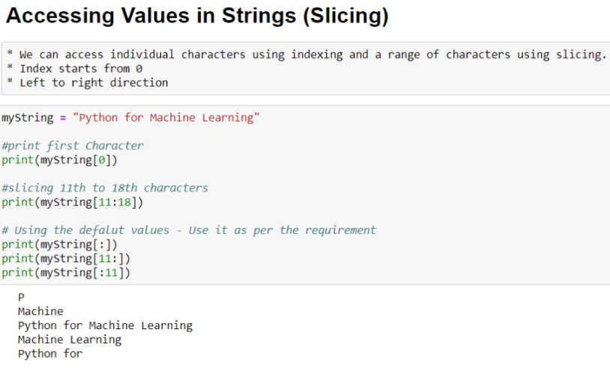

Slide 14
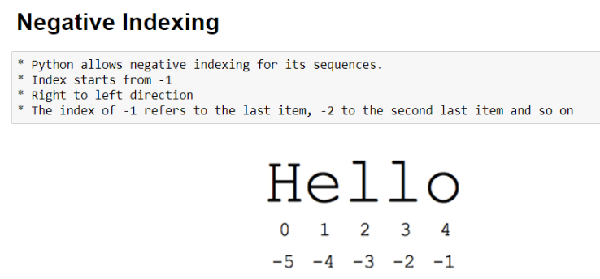
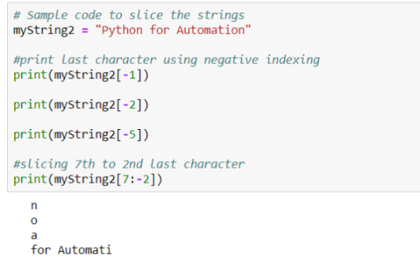

Slide 15
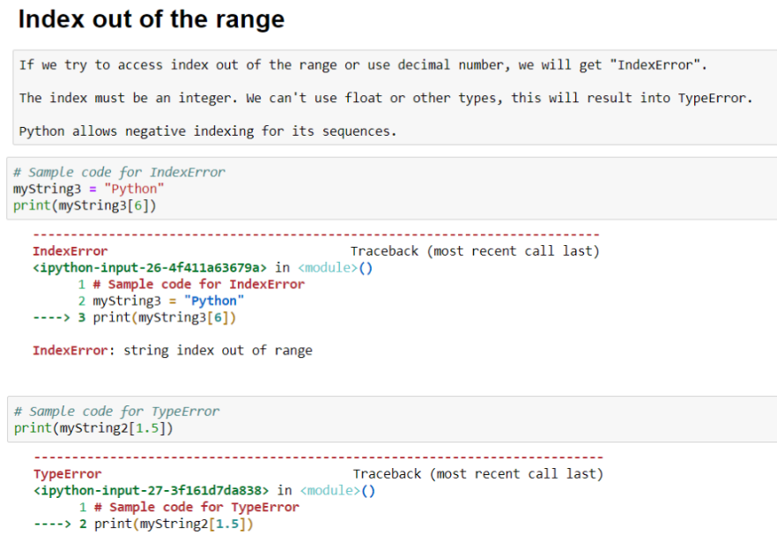

Slide 16
